Slide 1
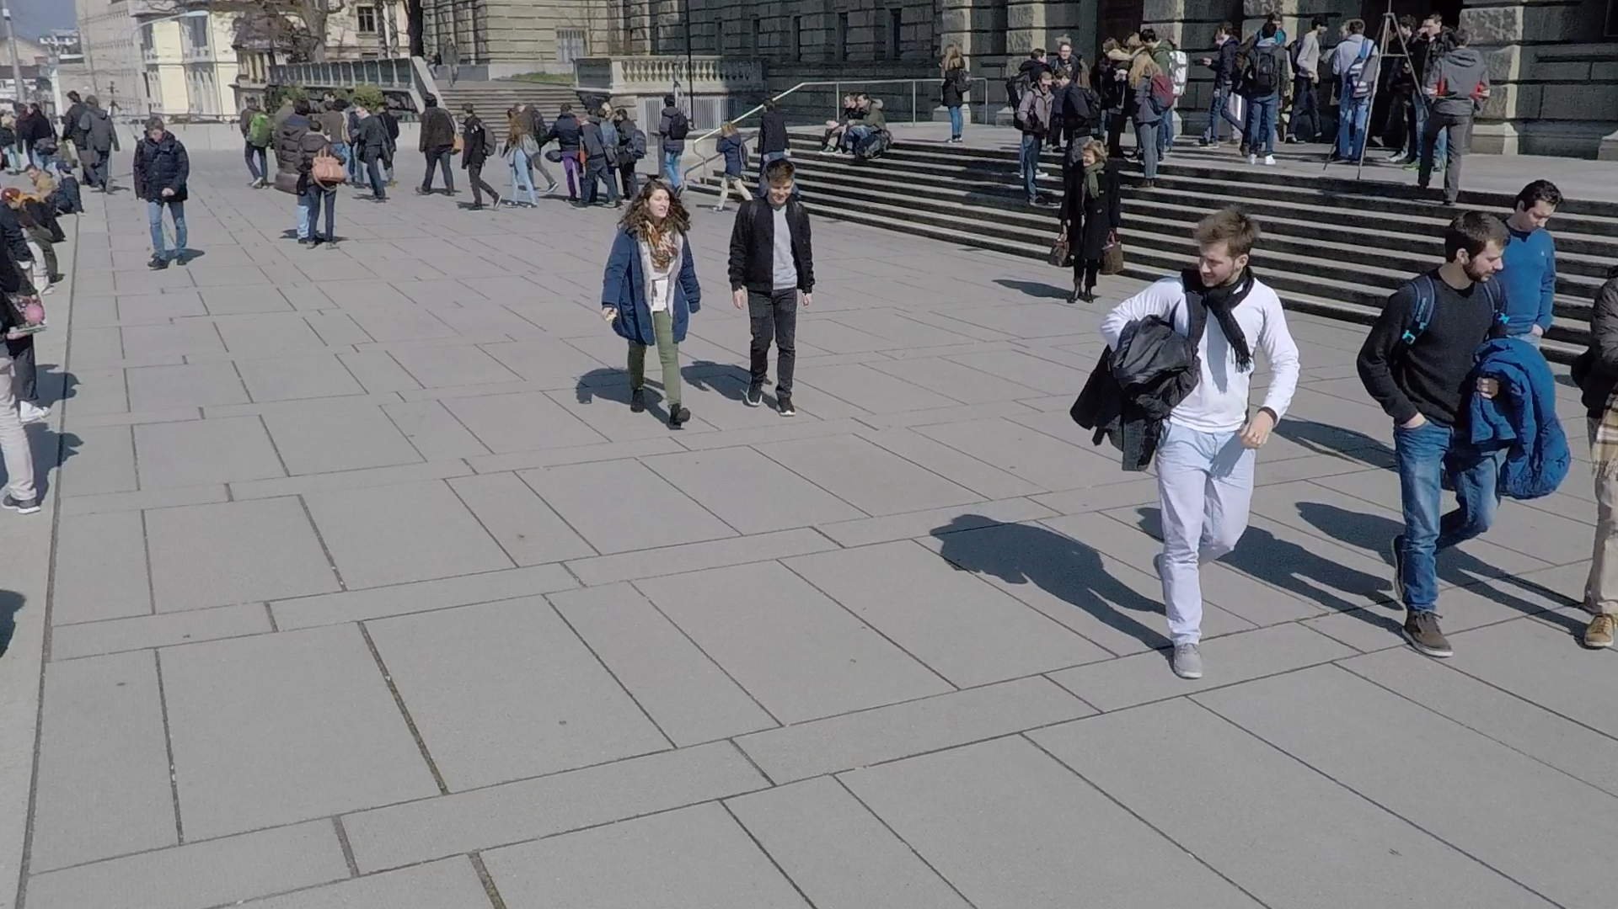
Experimental Results: Gaining Original Perspectives
Goal: Obtain perspective from Pedestrian A and B with (4) targets from 2D image
B
2
A
1
3
4

Slide 2
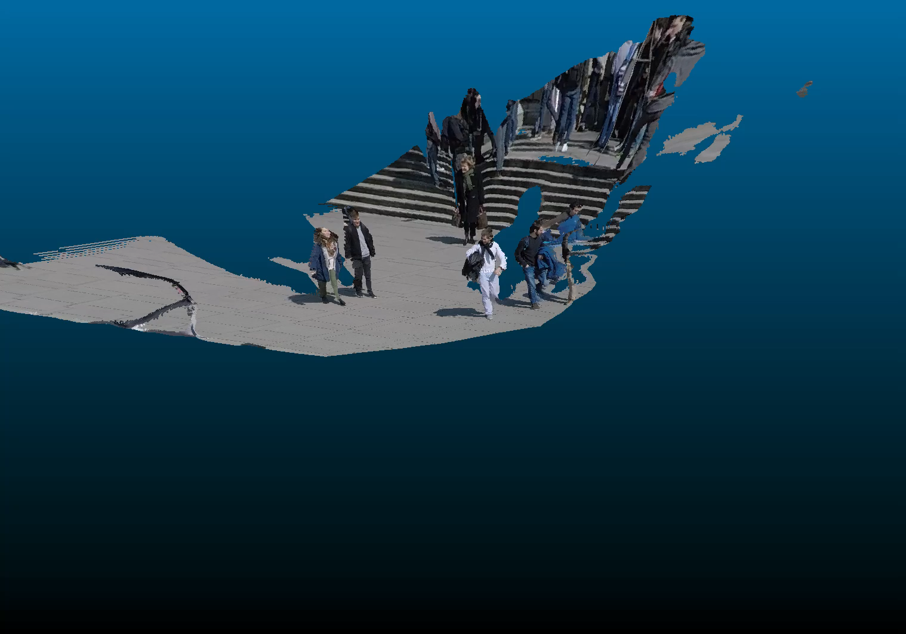
A

